Slide 1

Illustrative Example (Simpler Setting)

Slide 2
I deleted a bunch of slides from John’s slide deck to reduce the PPT

Slide 3
Two-Way ANOVA

Slide 4

Illustrative Example
ANOVA
Dependent variable ($y$) is continuous;
Independent variables ($x$) are categorical or Factors;
M&M consumption vs country of origin
‘Dinner Party’ – M&Ms available
Dependent variable: (oz) people eat
Independent variables: Ethnic Origin and Labeling (Low Fat vs New Color)

Slide 5
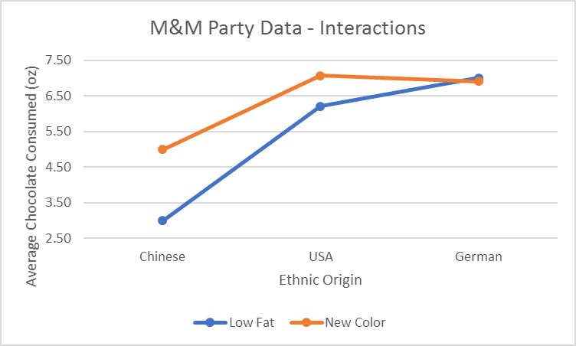
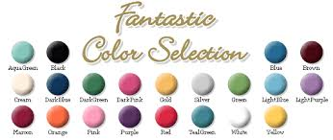

Illustrative Example

Slide 6
Primary Questions in Two-way ANOVA
Is anything going on? (Two Factors)
Does either factor (or their interactions) make a difference?
Are there Interactions?
Sum of Squares Regression (F-test) – Bigger is Better
Bayesian P-values
Posterior Probability of No Interactions
(Differences in means of one Factor the same, regardless of level of other factor)
Example: Does knowing the marginal means explain everything?

Slide 7
Primary Questions in Two-way ANOVA
What is going on? (Two Factor)
Where are the differences in the differences?
‘Conditional Collapse’: collapsing one factor, conditional on another factor
Posterior Probability of Different Groupings (Models) of Factor levels
Example: Do the Ethnic Origins group differently based on the Labeling?

Slide 8
Two-way ANOVA d as a d One-way ANOVA

Slide 9

Two-way ANOVA Model
Traditional Model – No Interaction
$$y_{t}=\overline{μ}+μ_{1s_{1t}}+μ_{2s_{2t}}+ε_{t}$$
$=\overline{μ}+\sum_{i}{I\left\{s_{1t}=i\right\}μ_{1i}}+\sum_{j}{I\left\{s_{2t}=j\right\}μ_{2j}}+ε_{t}$
$\overline{μ}$ = overall mean
$μ_{1i}$ = deviation from overall mean for i^{th} level of Factor 1
$s_{1t}$= multinomial variable indicating the t^{th} observation has i^{th} level for Factor 1
$μ_{2j}$ = deviation from overall mean for j^{th} level of Factor 2
$s_{2t}$= multinomial variable indicating the t^{th} observation has j^{th} level for Factor 2

Slide 10
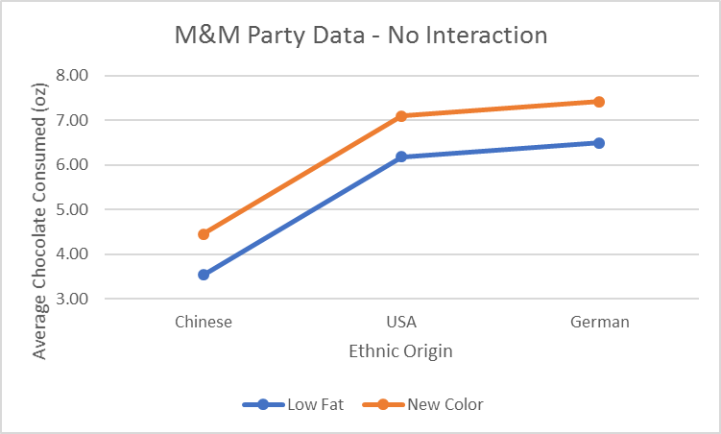
Illustrative Example

Slide 11

Two-way ANOVA Model
Traditional Model – With Interaction
$y_{t}=\overline{μ}+μ_{1s_{1t}}+μ_{2s_{2t}}+{γ_{s_{1t}s_{2t}}+ε}_{t}$
$=\overline{μ}+\sum_{i}{I\left\{s_{1t}=i\right\}μ_{1i}}+\sum_{j}{I\left\{s_{2t}=j\right\}μ_{2j}}$
$+{\sum_{ij}{I\left\{s_{1t}=i\right\}I\left\{s_{2t}=j\right\}γ_{ij}}+ε}_{t}$
$\overline{μ}$ = overall mean
$μ_{1i}$ = deviation from overall mean for i^{th} level of Factor 1
$μ_{2j}$ = deviation from overall mean for j^{th} level of Factor 2
$γ_{ij}$= extra deviation specific to i^{th} level of Factor 1 and j^{th} level of Factor 2

Slide 12
Illustrative Example

Slide 13
New Models d from d Old Models
(Two-Way)
(One-Way)

Slide 14

Two-way ANOVA via Super Factor
‘Telephone Order’ Factors and Super Factor
Super Factor to Factor Mapping: Super Factor ($K_{1}×K_{2}$levels)
$s_{1t}=i$ and $s_{2t}=j$, then $s_{pt}=ℓ=\left(i−1\right)K_{2}+j$
 |  | Ethnic Origin
 |  | Ch | USA | Gr
Label | Low Fat | 1 | 2 | 3
 | New Color | 4 | 5 | 6
Super Factor

Slide 15

Two-way ANOVA via Super Factor
Super Factor One-way ANOVA of a Two-way ANOVA
$y_{t}=\overline{μ}+μ_{ps_{pt}}+ε_{t}$
$=\overline{μ}+\sum_{ℓ}{I\left\{s_{pt}=ℓ\right\}μ_{pℓ}}+ε_{t}$
$\overline{μ}$ = overall mean; $μ_{pℓ}$ = deviation from overall mean for $ℓ$^{th} level of Super Factor
Super Factor to Factor Mapping: Factor 1 ($K_{1}$ levels) and Factor 2 ($K_{2}$ levels)
$s_{pt}=ℓ$, then $s_{1t}=i=\left\lfloor \frac{ℓ−1}{K_{2}}\right\rfloor +1$ and $s_{2t}=j=ℓ−\left\lfloor \frac{ℓ−1}{K_{2}}\right\rfloor K_{2}$,
where means integer part, so $\left\lfloor \frac{3}{2}\right\rfloor$ = 1

Slide 16
Two-way ANOVA Anything Going On?

Slide 17
Primary Questions in Two-way ANOVA
Is anything going on? (Two Factors)
Does either factor (or their interactions) make a difference?
Are there Interactions?
Sum of Squares Regression (F-test) – Bigger is Better
Bayesian P-values
Posterior Probability of No Interactions
(Differences in means of one Factor the same, regardless of level of other factor)
Example: Does knowing the marginal means for Ethnic Origin and Label explain everything?

Slide 18




Testing Interactions with the Super Factor
Normalize the data (subtract away the marginal means)
$${\tilde{y}}_{t}=y_{t}−{\overline{y}}_{1s_{1t}}−{\overline{y}}_{2s_{2t}}+\overline{y}≅y_{t}−\overline{μ}−μ_{1s_{1t}}−μ_{2s_{2t}}={γ_{s_{1t}s_{2t}}+ε}_{t}$$
$\overline{μ}≅\overline{y}$
$$μ_{1i}≅{\overline{y}}_{1i}−\overline{y}$$
$$μ_{2j}≅{\overline{y}}_{2j}−\overline{y}$$
$${\overline{\tilde{y}}}_{t}=0$$

Slide 19
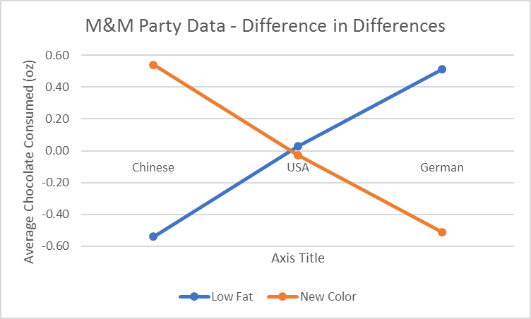
Illustrative Example
_
_
_

Slide 20



Testing Interactions with the Super Factor
One-way ANOVA of ${\tilde{y}}_{t}$ using a Super Factor
Fundamental question is SSR different from zero? If yes, then something is going on … need more than marginal means, need an interaction $γ_{ij}$.
$${\tilde{y}}_{t}=\overline{\tilde{μ}}+μ_{ps_{pt}}+{ε_{t}=γ_{s_{1t}s_{2t}}+ε}_{t}$$
$$\hat{\overline{\tilde{μ}}}=0$$
$${\tilde{y}}_{t}=μ_{ps_{pt}}+ε_{t}$$

Slide 21






Illustrative Example
$$μ_{p1}$$
$$μ_{p2}$$
$$μ_{p3}$$
_
_
_
$$μ_{p4}$$
$$μ_{p5}$$
$$μ_{p6}$$

Slide 22

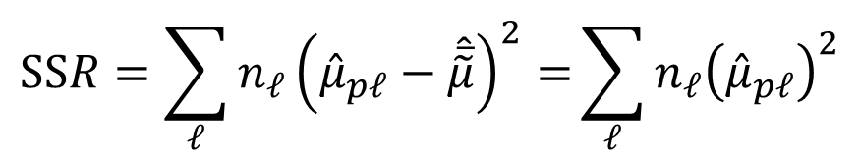
Testing Interactions with the Super Factor
One-way ANOVA of ${\tilde{y}}_{t}$ using a Super Factor
Fundamental question is SSR different from zero? If yes, then something is going on … need more than marginal means, need an interaction $γ_{ij}$.
$${\tilde{y}}_{t}=\overline{\tilde{μ}}+μ_{ps_{pt}}+{ε_{t}=γ_{s_{1t}s_{2t}}+ε}_{t}$$
$$\hat{\overline{\tilde{μ}}}=0$$
$$SSR=\sum_{ℓ}{{n_{ℓ}\left({\hat{μ}}_{pℓ}−\hat{\overline{\tilde{μ}}}\right)}^{2}=}\sum_{ℓ}{{n_{ℓ}\left({\hat{μ}}_{pℓ}\right)}^{2}}$$

Slide 23

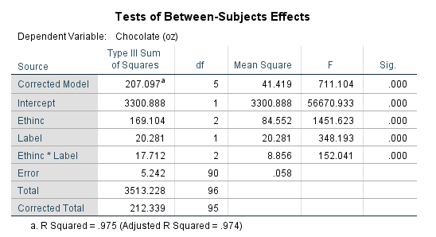
Sum of Squares Regression

Slide 24

Testing Interactions with the Super Factor
One-way ANOVA of ${\tilde{y}}_{t}$ using a Super Factor
Can use to calculate the distribution of SSR – Gelman (2005)
Can use to calculate a Bayesian P-Value – Dong & Wedel (2014)
Can use to calculate posterior probability of an intercept only
All test whether interactions exists (whether $γ_{ij}$ different from 0)

Slide 25
One-way ANOVA: Anything Going On?
Factor | MLE SSR | Post Dist. SSR | P-Value | Joint Bayes P-Value | Probability Intercept Only
Overall
Ethnic | 169.10 |  | 0.000 | 0.000 | 0.000
Label | 20.28 |  | 0.000 | 0.085 | 0.011
E*L | 17.71 |  | 0.000 | 0.000
?

Slide 26
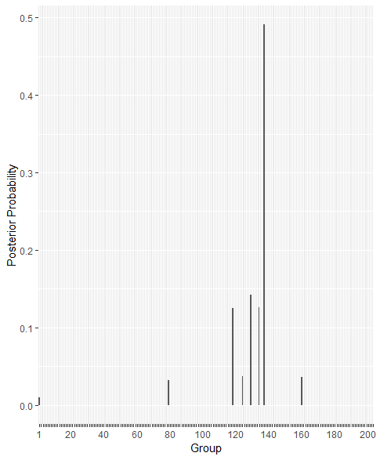

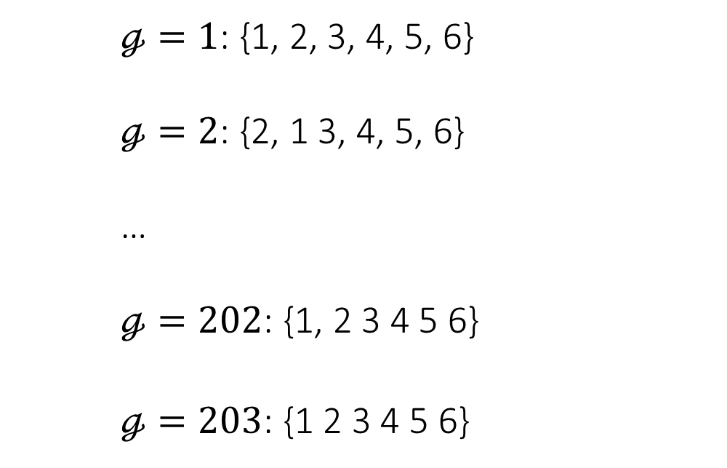
Testing Interactions with the Super Factor
203 Possible Groups
$ℊ=1$: {1, 2, 3, 4, 5, 6}
$ℊ=2$: {2, 1 3, 4, 5, 6}
…
$ℊ=202$: {1, 2 3 4 5 6}
$ℊ=203$: {1 2 3 4 5 6}
$$Intercept Only$$

Slide 27
One-way ANOVA: Anything Going On?
Factor | MLE SSR | Post Dist. SSR | P-Value | Joint Bayes P-Value | Probability Intercept Only
Overall
Ethnic | 169.10 |  | 0.000 | 0.000 | 0.000
Label | 20.28 |  | 0.000 | 0.085 | 0.011
E*L | 17.71 |  | 0.000 | 0.000 | 0.000

Slide 28

Illustrative Example
Wrong!

Slide 29
Primary Questions in Two-way ANOVA
Is anything going on? (Two Factors)
Does either factor (or their interactions) make a difference?
Are there Interactions?
Sum of Squares Regression (F-test) – Bigger is Better
Bayesian P-values
Posterior Probability of No Interactions
(Differences in means of one Factor the same, regardless of level of other factor)
Example: Does Ethnic Origin, the Labels or any combination make a difference?

Slide 30
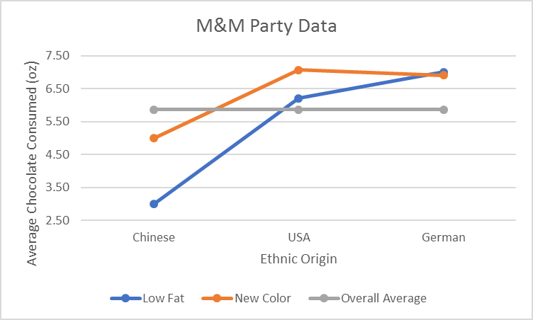
Testing Interactions with the Super Factor
DO NOT Normalize the data
(Super Factor cells different, Factors or Interaction matter)
$$y_{t}=\overline{μ}+μ_{ps_{pt}}+ε_{t}$$

Slide 31
Sum of Squares Regression

Slide 32
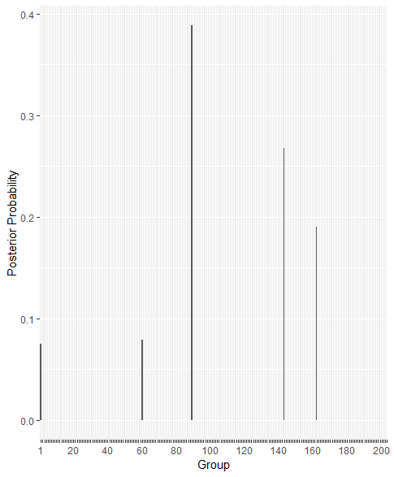
Non Mean Centered with the Super Factor
203 Possible Groups
$ℊ=1$: {1, 2, 3, 4, 5, 6}
$ℊ=2$: {2, 1 3, 4, 5, 6}
…
$ℊ=202$: {1, 2 3 4 5 6}
$ℊ=203$: {1 2 3 4 5 6}
$$Intercept Only$$

Slide 33
One-way ANOVA: Anything Going On?
Factor | MLE SSR | Post Dist. SSR | P-Value | Joint Bayes P-Value | Probability Intercept Only
Overall | 207.01 |  | 0.000 | 0.000 | 0.000
Ethnic | 169.10 |  | 0.000 | 0.000 | 0.000
Label | 20.28 |  | 0.000 | 0.085 | 0.011
E*L | 17.71 |  | 0.000 | 0.000 | 0.000

Slide 34
Two-way ANOVA What is Going On?

Slide 35
Primary Questions in Two-way ANOVA
What is going on? (Two Factor)
Where are the differences in the differences?
‘Conditional Collapse’: collapsing one factor, conditional on another factor
Posterior Probability of Different Groupings (Models) of Factor levels
Example: Do the Ethnic Origins group differently based on the Labeling?

Slide 36
Difference in the Differences
No interaction – differences the same regardless of other Factor
 |  | Ethnic Origin
 |  | Ch | USA | Gr
Label | Low Fat | 1 | 2 | 3
 | New Color | 4 | 5 | 6
3 Groups for Ethnicity | Low Fat
2 Groups for Ethnicity | New Color

Slide 37
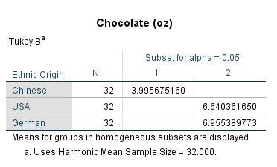
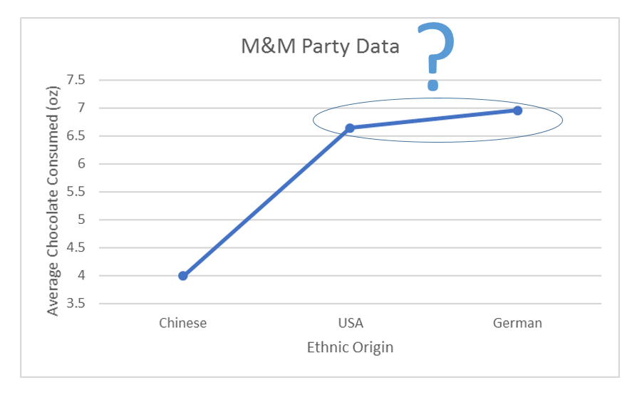
Mean Comparisons: SKN, Tukey …
Group 1: Post. Prob = 69.25%
Ethnic | 1 | 2 | 3
Chinese | 4.00
USA |  | 6.64
German |  |  | 6.96
Group 4: Post. Prob = 30.75%
Ethnic | 1 | 2
Chinese | 4.00
USA |  | 6.80
German

Slide 38

Probability of Different Groups | Low Fat
Group 1: Post. Prob = 100%
Size | 1 | 2 | 3
Chinese | 3.00
USA |  | 6.21
German |  |  | 7.01
$ℊ=1$: {1, 2, 3}
$ℊ=2$: {1 2, 3}
…
$ℊ=5$: {1 2 3}

Slide 39

Probability of Different Groups | New Color
Group 1: Post. Prob = 53.26%
Size | 1 | 2 | 3
Chinese | 5.00
USA |  | 7.07
German |  |  | 6.90
$ℊ=1$: {1, 2, 3}
$ℊ=2$: {1 2, 3}
…
$ℊ=4$: {1, 2 3}
$ℊ=5$: {1 2 3}
Group 4: Post. Prob = 46.74%
Size | 1 | 2
Chinese | 5.00
USA |  | 6.99
German

Slide 40
Variable dimension sampler
Idea:
model as super factor; collapse the cells
Investigate marginals and interactions by mapping back cell means following Knuiman and Speed 1988; Dellaportas and Forster 1999
Compute ANOVA table following Gelman from implied marginal, interaction terms (previous point)
Focus on Bayesian Model Averaging (BMA), e.g. Kaplan (2021 PMKA): do not select one final model but average over a space of possible models that could have been the DGP
Two samplers: independence sampler and Dirichlet process prior sampler

Slide 41

Leading example: 2x3 ANOVA
Examine a few cases to see if we can collapse the cells
In all cases: 50 observations per cell and variance = 1

Slide 42
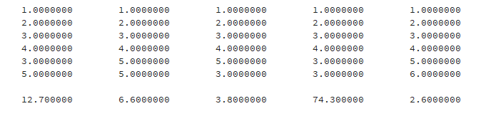

Example 1
Cell means (DGP) | China | USA | Germany
New color | 3 | 6 | 7
Low fat | 5 | 7 | 7
203 possible models; true model (read rowwise): 123433
DPP sampler
Independence sampler

Slide 43
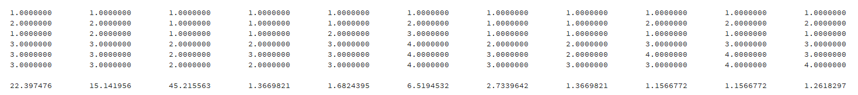
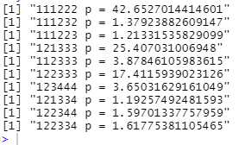
Example 2
Cell means (DGP) | China | USA | Germany
New color | 5 | 5 | 5
Low fat | 7 | 7 | 7
203 possible models; true model (read rowwise): 111222
DPP sampler
Independence sampler

Slide 44
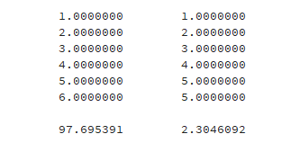

Example 3
Cell means (DGP) | China | USA | Germany
New color | 1 | 2 | 3
Low fat | 6 | 5 | 4
203 possible models; true model (read rowwise): 123456
DPP sampler
Independence sampler

Slide 45
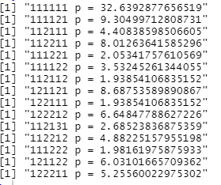
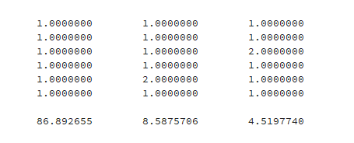
Example 4
Cell means (DGP) | China | USA | Germany
New color | 5 | 5 | 5
Low fat | 5 | 5 | 5
203 possible models; true model (read rowwise): 111111
Independence sampler
DPP sampler

Slide 46
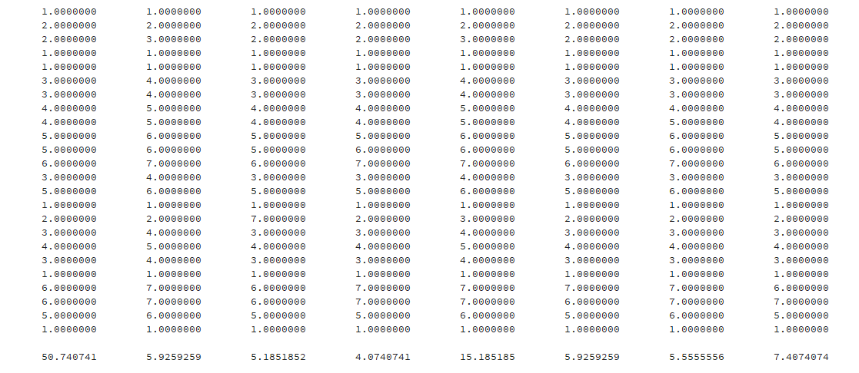
Example 5
3 factors: 3*2*4 = 24 cells
Possible number of models: bell(24) = 4.459589e+17
True model (as collapse): 122113344556351234316651

Slide 47
Open Qs
The two approaches tend to agree but can also differ
What are the “true” probabilities? Can we compare with John L.’s exact approach?
Disadvantage independence sampler: does not scale
Disadvantage DPP sampler: seems to be sensitive to prior values of the DPP; may logically speaking not be an appropriate model
What *is* the story? Is this a smart way to do ANOVA? How can we test for things (e.g. interactions)? Some (not yet fully satisfactory) examples next..

Slide 48
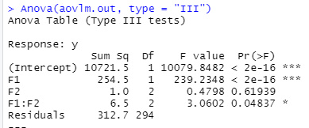
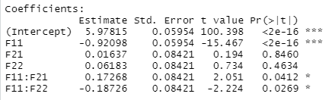
Example 6: investigate interactions
[[ not yet implemented for DPP so results are from independence sampler ]]
For this simulated dataset (with bit of fiddling on top in cell [USA, Low fat]), classical ANOVA suggests there is an interaction (although not strong); no factor 2
Top model BMA: 111222 (p=59%IS, 57%DPP), 111232 (p=17%IS, 14%DPP)
Cell means (DGP); sample means | China | USA | Germany
New color | 5; 5.25 | 5; 4.93 | 5; 4.99
Low fat | 7; 6.74 | 7; 7.15 | 7; 6.81

Slide 49
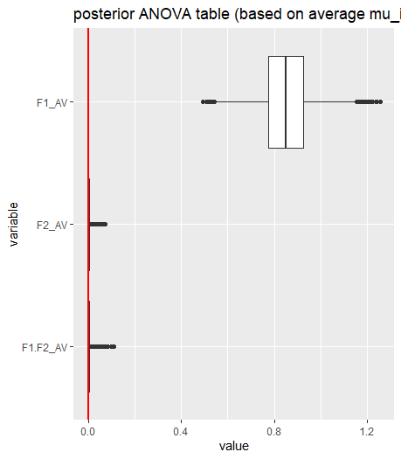
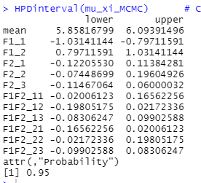
Example 6: investigate interactions
[[ not yet implemented for DPP so results are from independence sampler ]]
BMA: no interaction as HPDs include 0;
ANOVA table also highlights this
Cell means (DGP); sample means | China | USA | Germany
New color | 5; 5.25 | 5; 4.93 | 5; 4.99
Low fat | 7; 6.74 | 7; 7.15 | 7; 6.81

Slide 50
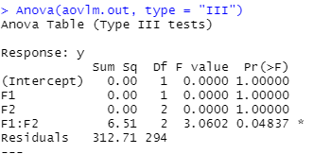
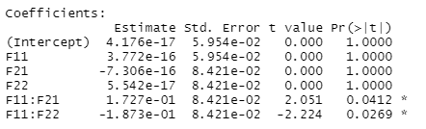
Example 6: investigate interactions
[[ not yet implemented for DPP so results are from independence sampler ]]
Subtracting out the marginals; normalizing the data; does not change results classical ANOVA; but BMA results change
Top model: 111111 (p=59%IS; 91%DPP)
Cell means (DGP); sample means | China | USA | Germany
New color | 5; 5.25 | 5; 4.93 | 5; 4.99
Low fat | 7; 6.74 | 7; 7.15 | 7; 6.81

Slide 51
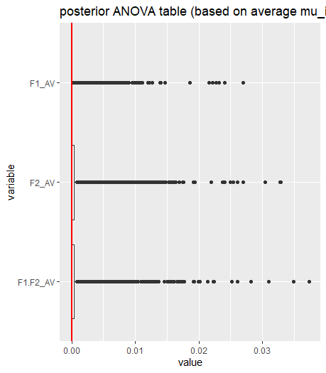
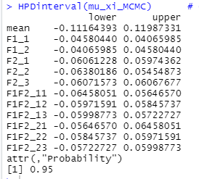
Example 6: investigate interactions
[[ not yet implemented for DPP so results are from independence sampler ]]
Subtracting out the marginals; normalizing the data; does not change results classical ANOVA; but BMA results change
Cell means (DGP); sample means | China | USA | Germany
New color | 5; 5.25 | 5; 4.93 | 5; 4.99
Low fat | 7; 6.74 | 7; 7.15 | 7; 6.81

Slide 52
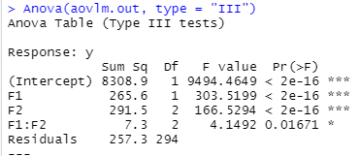
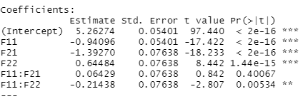
Example 7: investigate interactions
[[ not yet implemented for DPP so results are from independence sampler ]]
For this simulated dataset, classical ANOVA suggests there is an interaction, coming from F11:F22 but not F11:F21
Top model BMA: 123244 (p=56%IS, 51%DPP), 122233 (p=28%IS, 17%DPP),
Cell means (DGP); sample means | China | USA | Germany
New color | 3; 3.00 | 5; 4.79 | 5; 5.14
Low fat | 5; 4.79 | 7; 6.95 | 7; 6.90

Slide 53
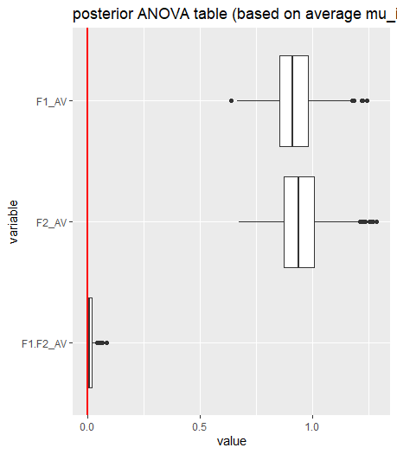
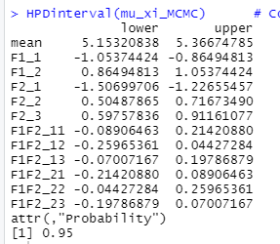
Example 7: investigate interactions
[[ not yet implemented for DPP so results are from independence sampler ]]
BMA: no interaction as HPDs include 0;
ANOVA table also highlights this
Cell means (DGP); sample means | China | USA | Germany
New color | 3; 3.00 | 5; 4.79 | 5; 5.14
Low fat | 5; 4.79 | 7; 6.95 | 7; 6.90

Slide 54
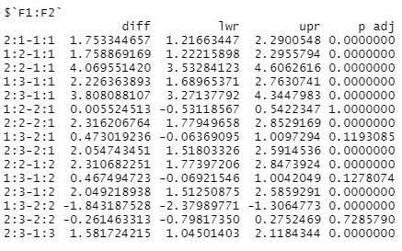
Example 7: investigate interactions
[[ not yet implemented for DPP so results are from independence sampler ]]
Note that Tukey seems to be a strong contender; most examples I examined so far this procedure gets it right; here it is ‘more correct’ than BMA
Cell means (DGP); sample means | China | USA | Germany
New color | 3; 3.00 | 5; 4.79 | 5; 5.14
Low fat | 5; 4.79 | 7; 6.95 | 7; 6.90
NC-USA = LF-China
NC-GER = LF-China
Correct model: 122233
NC-GER = NC-USA
(But given this, can we have an interaction?)
LF-GER = LF-USA

Slide 55
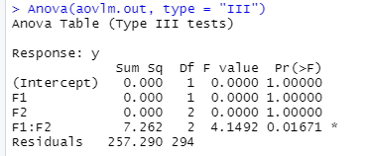
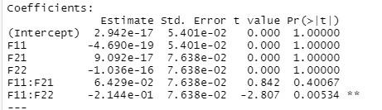
Example 7: investigate interactions
[[ not yet implemented for DPP so results are from independence sampler ]]
Subtracting out the marginals; normalizing the data; does not change results classical ANOVA; but BMA results change
Top model: 111111 (p=56%IS; 86%DPP)
Cell means (DGP); sample means | China | USA | Germany
New color | 3; 3.00 | 5; 4.79 | 5; 5.14
Low fat | 5; 4.79 | 7; 6.95 | 7; 6.90

Slide 56
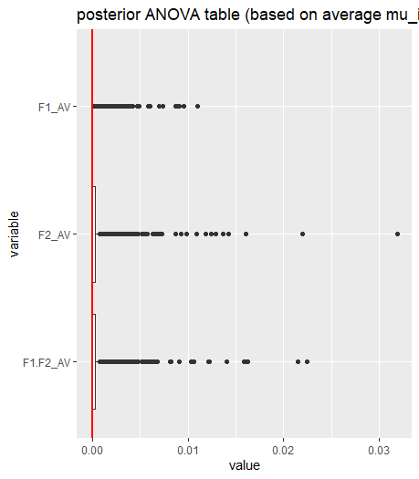
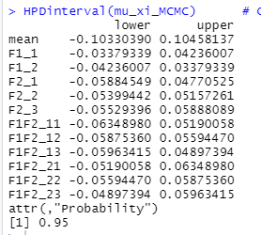
Example 7: investigate interactions
[[ not yet implemented for DPP so results are from independence sampler ]]
Subtracting out the marginals; normalizing the data; does not change results classical ANOVA; but BMA results change
Cell means (DGP); sample means | China | USA | Germany
New color | 3; 3.00 | 5; 4.79 | 5; 5.14
Low fat | 5; 4.79 | 7; 6.95 | 7; 6.90

Slide 57
Open Qs
Can the superfactor model really test for interactions or is it just a Bayesian version of Tukey (that seems to perform worse)?
I don’t fully get the rational behind the mean centering:
Aren’t we using the data twice? Once for testing for the interaction and once for estimating the non-mean centered model?
How would this generalize to 3 or more factors?
Is the purpose of the BMA to propose an alternative to Tukey? We need different examples then.

